Slide 1
Name : Raja Lakshmi D
Reg No : 513121104308
College Name : Thanthai Periyar Government Institute of Technology
Department : Computer Science and Engineering
Year : Third Year
NM ID : au2251310019
Skill Build ID : rajiraji140802@gmail.com
Project Title : Denoising MNIST Images using Autoencoders

Slide 2
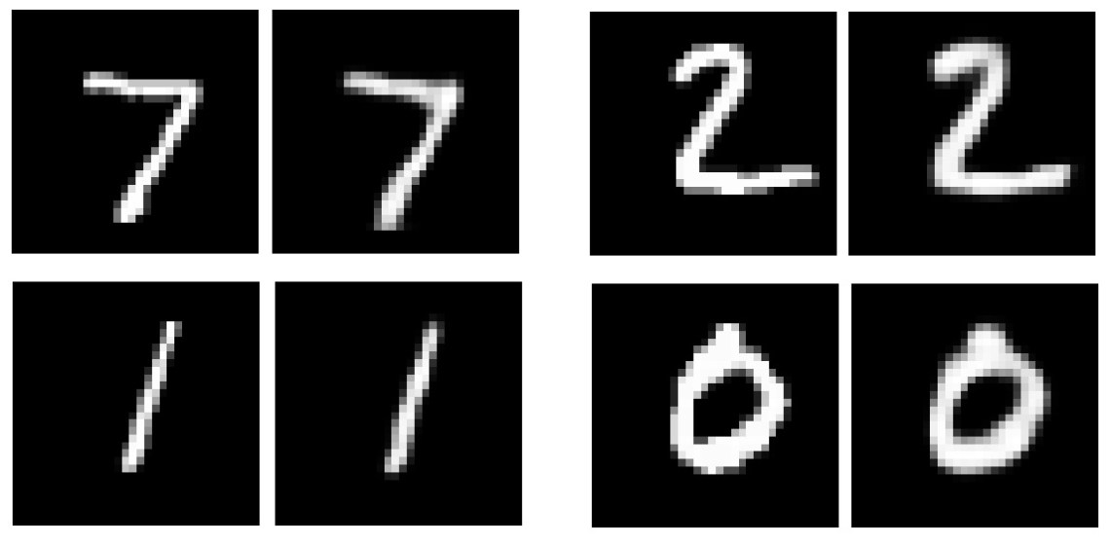
Project Title
Denoising MNIST Images using Autoencoders
Restoring Clarity to Noisy Digits with Deep Learning
This Photo by Unknown author is licensed under CC BY.

Slide 3

Agenda
Problem Statement
Project Overview
End Users
Solution and its value proportion
The wow in my solution
Modelling
Conclusion

Slide 4
Problem Statement
The objective of this mini-project is to develop a denoising model specifically tailored for images from the MNIST dataset, which comprises handwritten digits. The primary challenge is to effectively remove Gaussian noise from the images while preserving the essential features necessary for accurate digit recognition. The model is structured with an encoder network followed by a decoder network. The encoder learns to extract meaningful features from the noisy images, while the decoder aims to reconstruct clean versions by removing the noise.

Slide 5

Project Overview
The approach involves constructing a convolutional autoencoder architecture, comprising an encoder network for feature extraction and a decoder network for reconstructing clean images. The model is trained on noisy images as input, with clean images as targets, enabling it to learn to effectively remove noise.
The model's performance is evaluated through visualizations of real, noisy, and denoised images, providing qualitative insights into its effectiveness. Additionally, quantitative assessment using key metrics such as loss and accuracy ensures a comprehensive evaluation of the denoising model's efficacy for MNIST images.

Slide 6

End users
Researchers in Image Processing: Researchers in the field of image processing can utilize this project to explore denoising techniques specifically tailored for handwritten digit recognition tasks
Developers of OCR Systems: Developers working on optical character recognition (OCR) systems can integrate the denoising model developed in this project to enhance the accuracy of digit recognition.
Educators and Students in Machine Learning
This Photo by Unknown author is licensed under CC BY-NC-ND.
This Photo by Unknown author is licensed under CC BY-NC-ND.
This Photo by Unknown author is licensed under CC BY-NC-ND.
This Photo by Unknown author is licensed under CC BY-NC-ND.
This Photo by Unknown author is licensed under CC BY-NC-ND.
This Photo by Unknown author is licensed under CC BY-NC-ND.

Slide 7
My solution and its value proportion
Data Preparation: The project starts by loading and preprocessing the MNIST dataset, dividing it into training and testing sets. Gaussian noise is added to the images to simulate real-world conditions.
Model Construction: A convolutional autoencoder architecture is developed, consisting of encoder and decoder networks. The encoder extracts essential features from noisy images, while the decoder reconstructs clean images from these features.
Training and Evaluation: The model is trained using the noisy training images, aiming to minimize the difference between the noisy input and clean target images. Performance is evaluated qualitatively through visual inspection and quantitatively using metrics like loss and accuracy.

Slide 8
The wow in my solution
Tailored Denoising for MNIST: This project specializes in cleaning up noisy handwritten digit images from the MNIST dataset, ensuring clear and accurate digits for better recognition.
Smart Picture Cleanup: Using a special type of picture cleaning tool called a "convolutional autoencoder," this project effectively sifts through the noise in images and brings out the clear details of the handwritten digits.
Checking Twice for Accuracy: Not only does this project show you visually how well it cleaned up the images, but it also gives you numbers to confirm its success, ensuring it does a great job of cleaning up the messy pictures of digits.

Slide 9
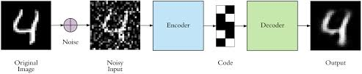
Modelling
Data Loading and Preprocessing:
Load MNIST dataset.
Divide dataset into training and testing sets.
Normalize pixel values.
Add Gaussian noise to create noisy images.
Model Architecture Design:
Design a convolutional autoencoder architecture.
Construct encoder and decoder networks.
Specify input and output shapes for the model.
Model Training:
Train the autoencoder model using noisy images as input and clean images as targets.
Optimize model parameters to minimize reconstruction error.
Iterate over epochs to improve model performance.
Model Evaluation:
Evaluate model performance using testing set.
Compute loss and accuracy metrics to measure denoising effectiveness.
Visualize denoised images for qualitative assessment.

Slide 10
Conclusion
The project demonstrates the effectiveness of convolutional autoencoders in denoising digit images.
Provides a foundation for further research and development in image denoising and related fields.
Concludes with a call to action for continued exploration and innovation in image processing and machine learning.

